Slide 1

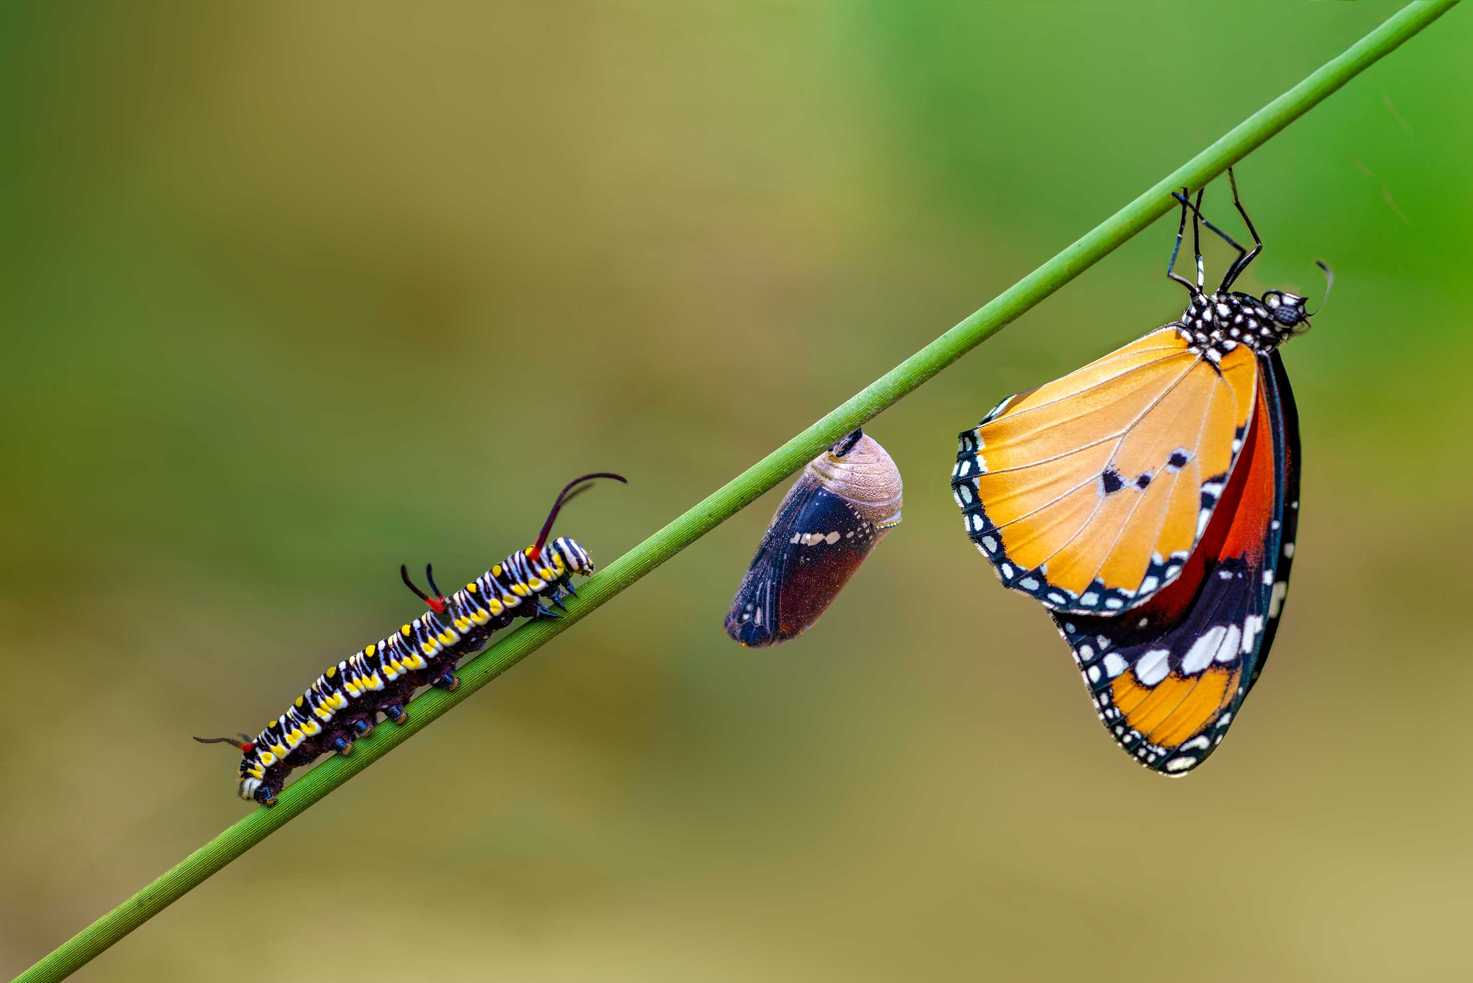
Code with Honor on the importance and beauty of software programming
Oracle Groundbreakers APAC Virtual Tour 2020, 21st October
Lucas Jellema, CTO & Architect AMIS | Conclusion

Slide 2
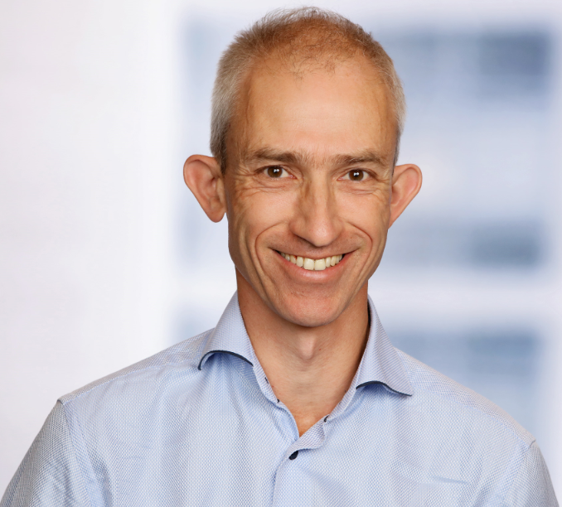
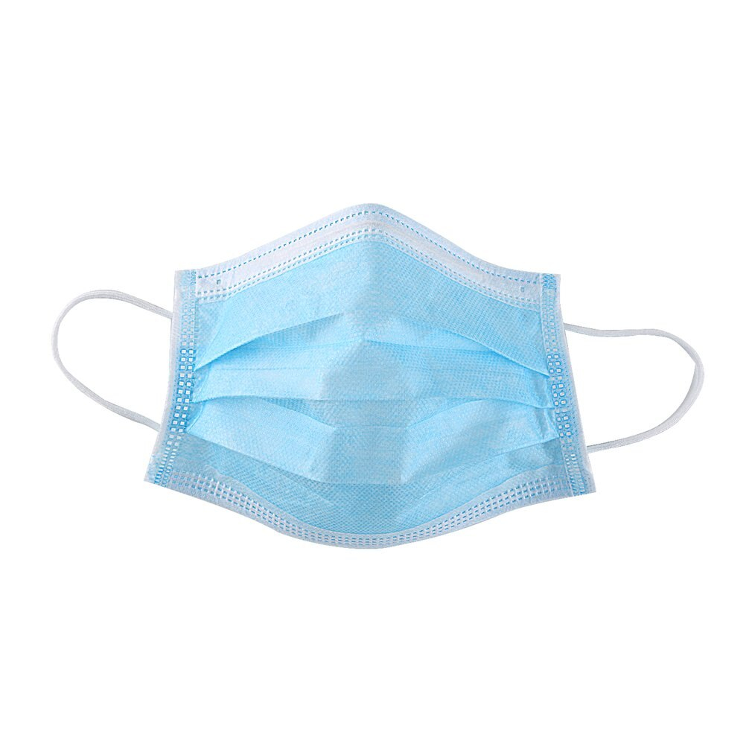
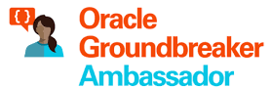



Lucas Jellema CTO for AMIS | Conclusion Cloud Solution Architect
lucas.jellema@amis.nl | technology.amis.nl | @lucasjellema | lucas-jellema

Slide 3


Slide 4
Professional Software

Slide 5
Professional Software

Slide 6
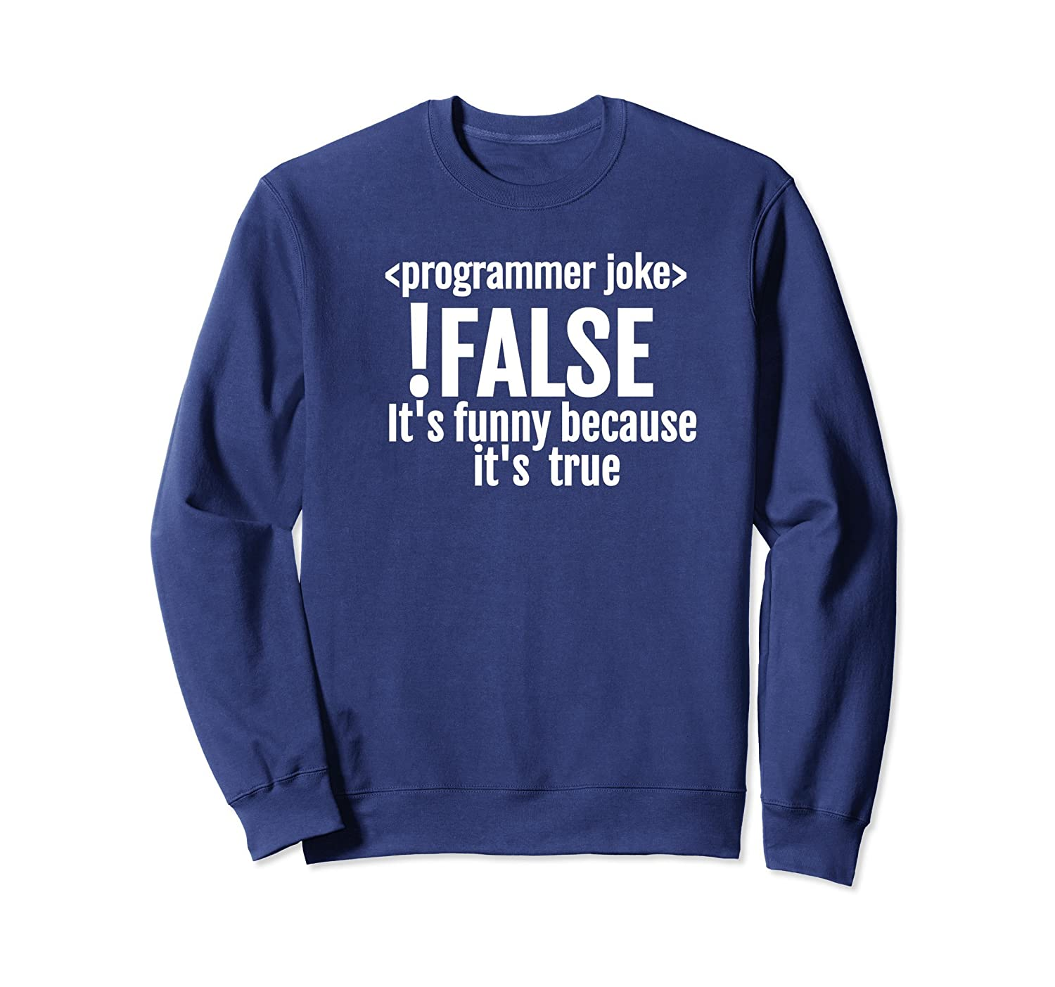
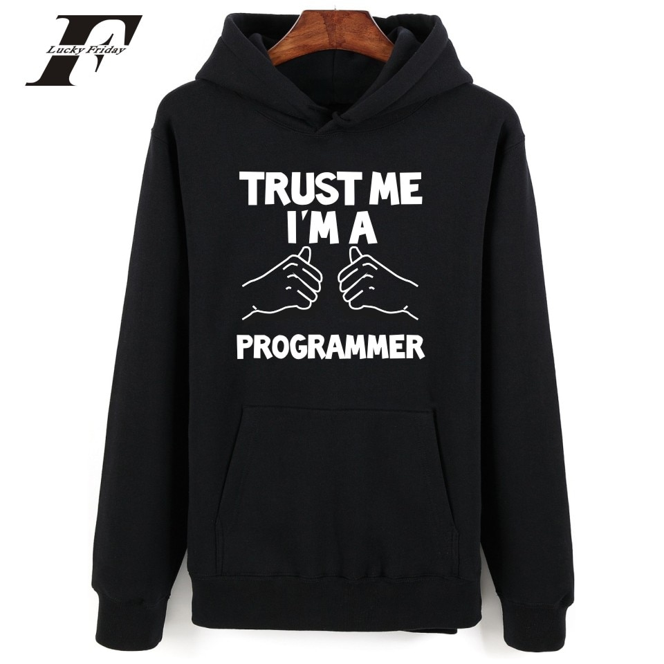
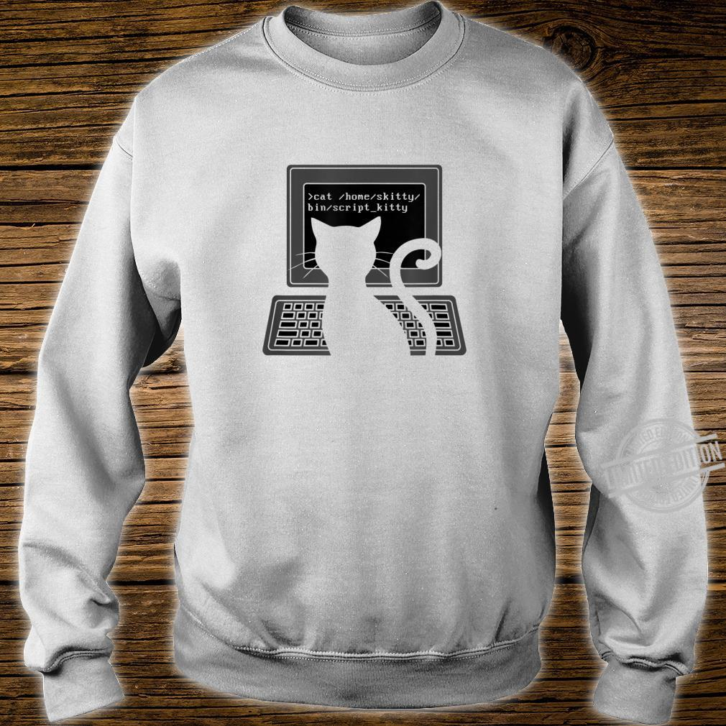

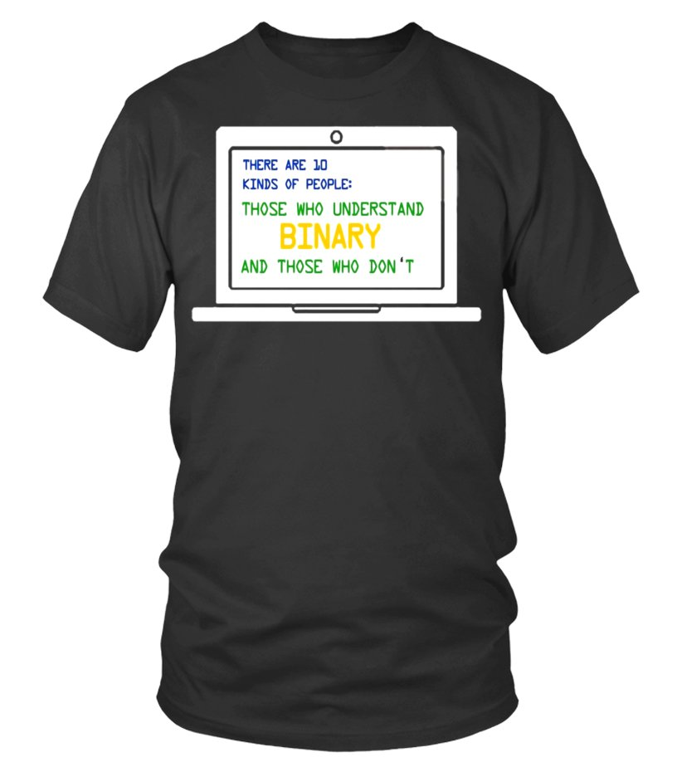
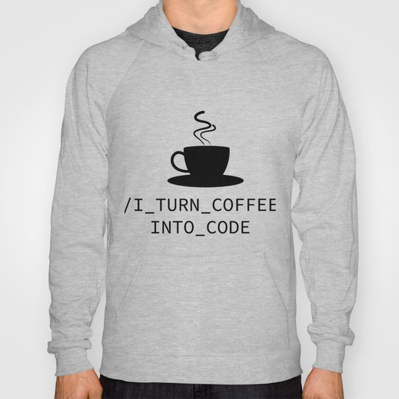
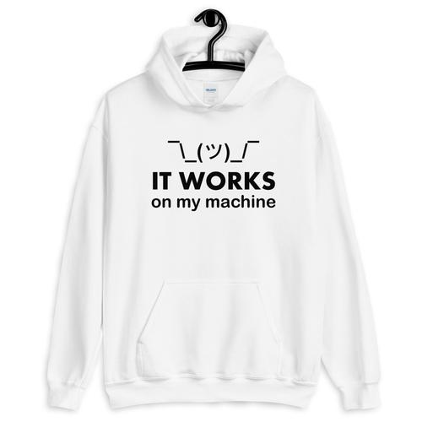
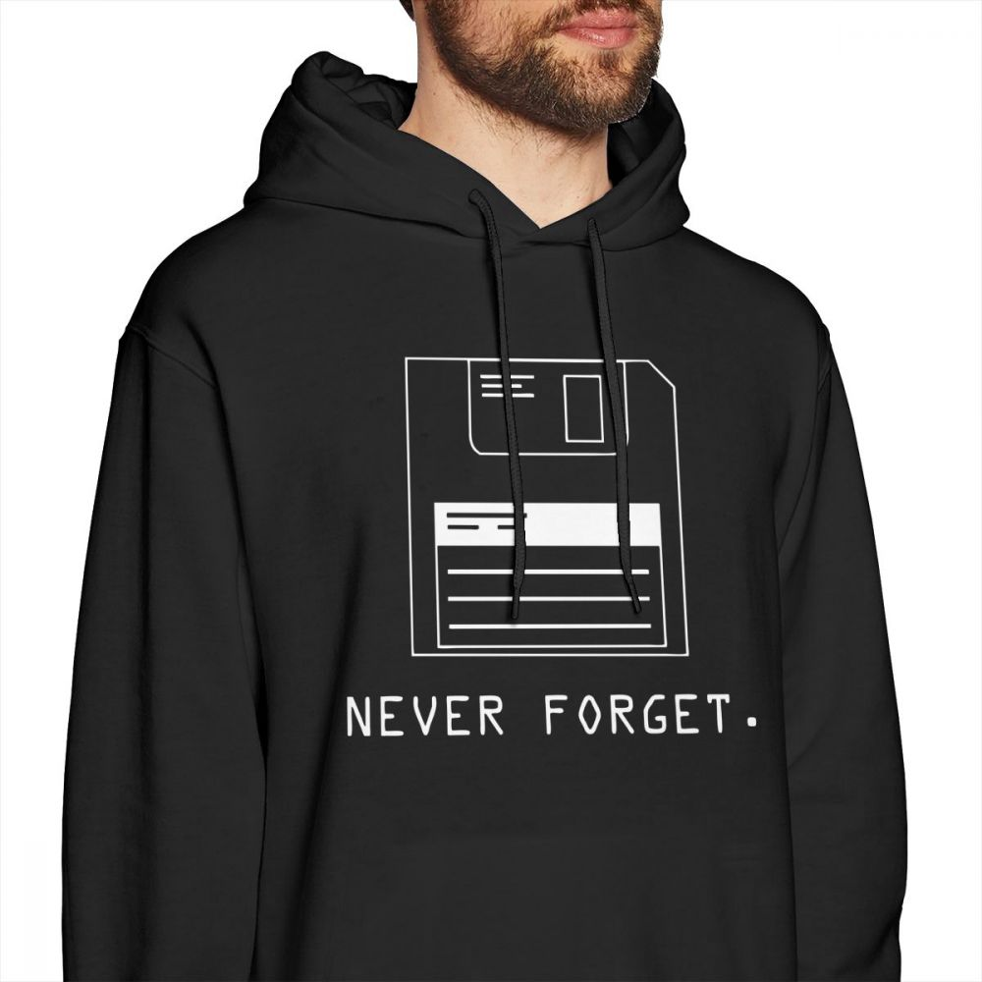
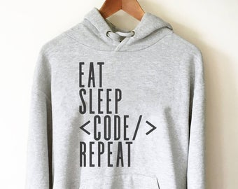

Slide 7


Slide 8
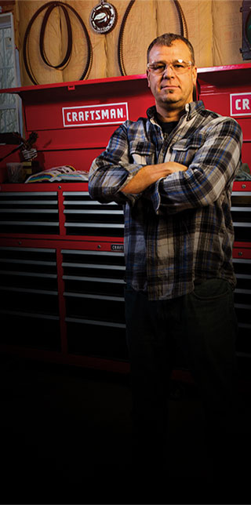

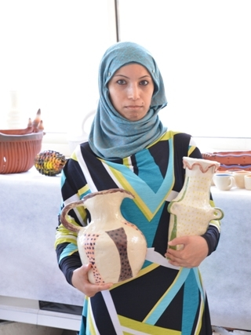

We are Proud Craftsmen

Slide 9


Slide 10
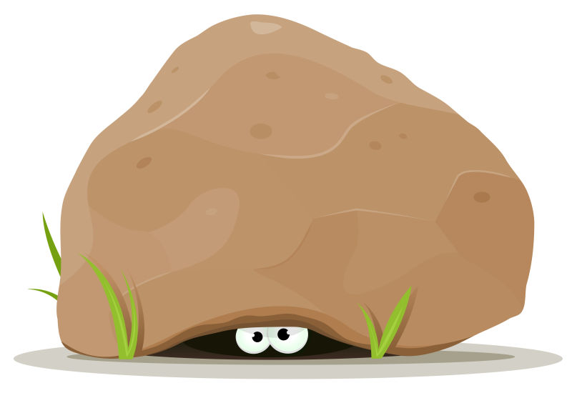

Slide 11
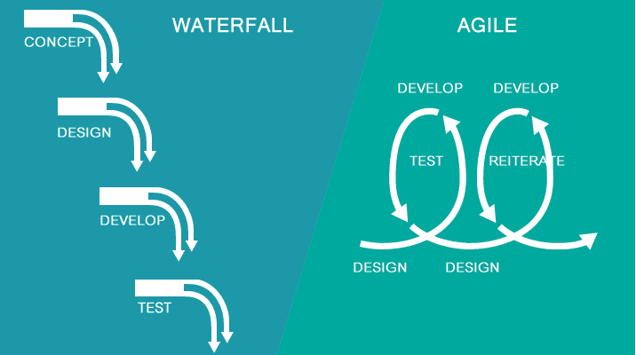
The Business

Slide 12
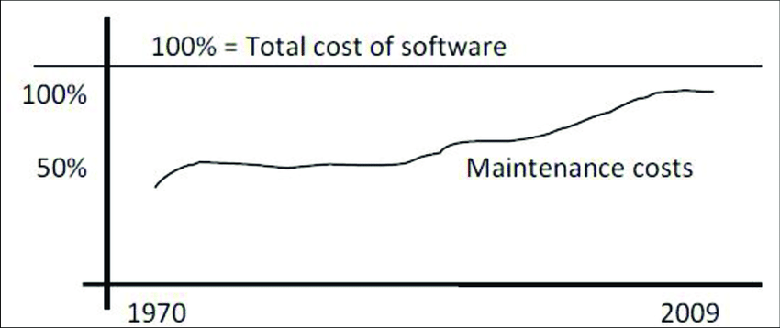
New Development costs

Slide 13
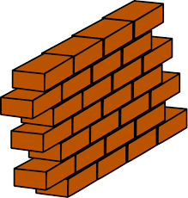


Development
scale, performance, security, stability, recoverability, monitoring
Production

Slide 14
Value and Cost of Software
go live
no value!

Slide 15

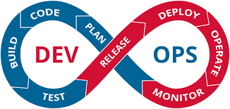
Dev ⬄ Ops
One team to
build
run
fix
evolve
the product
to really own the product
throughout its life cycle
Ops
Dev

Slide 16

Paid Lip Service
Testing
QA
CI/CD
Automation
Scalability
Production-like testing environments
Security
Architecture | Design Patterns

Slide 17
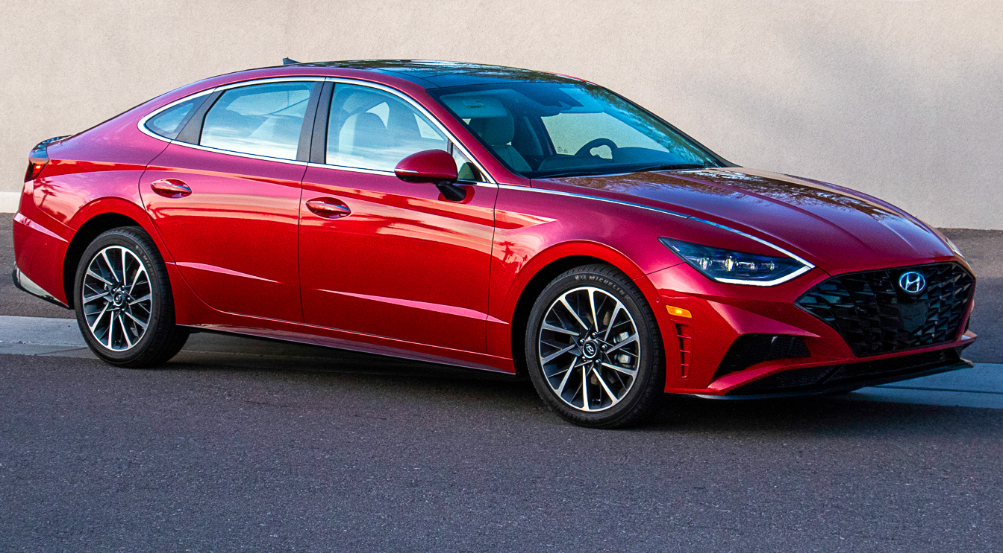
The Brake System is powered by Software
Your mother-in-law is about to get into the car
Your mother-in-law is about to get into the car
Your kids are about to get into the car
The quality of the brake software is similar to the code that you committed last week

Slide 18
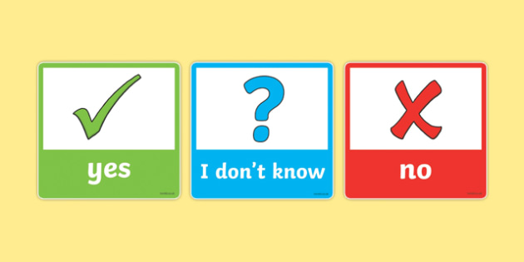
how do you know?
how do you know for sure what your software does and how it deals with real life?
why not?
what is your software good enough for? for a demo, a PoC or a striclty controlled prototype?
good enough to go to ACC (and let them find the bugs)?

Slide 19
What would you prefer:
We have no failing tests
We have some failing tests

Slide 20
What would you prefer:
We have no failing tests
We have some failing tests

Slide 21
What would you prefer:
We have 10% failing tests
We have 17.61 % failing tests

Slide 22
Professional Software
About me

Slide 23

About you as well?
A software professional who wants to
be proud of the professional software that you craft
take responsibility
towards society

Slide 24
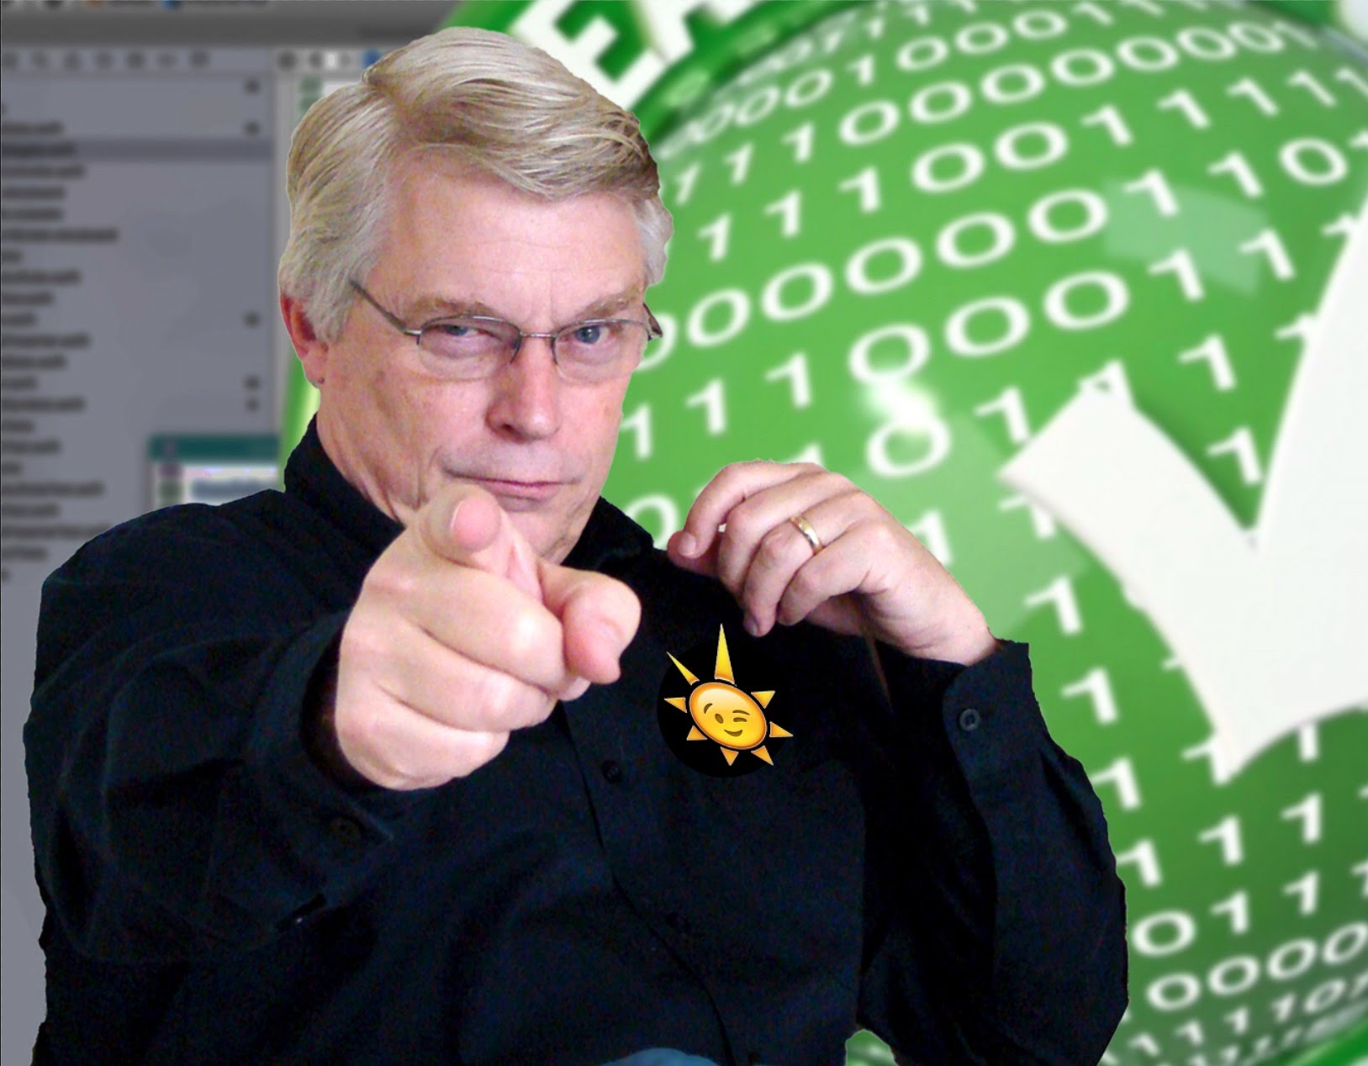
My awakening
So much software
So much dependency in society
health and safety, basic needs, education, climate, business success & failure, fun and comfort
Are we professionals? Can we be entrusted? Do we trust ourselves?

Slide 25

My Central Heating Guy
Functioning system: heating and shower get water with requested temperature (fast enough and in sufficient volume)
Within reasonable boundary conditions (-20° to 30° outside temperature) Safe & According to regulations Limited noise production, limited gas
Lasts a while (10-20 years) – robust, limited wear & tear
Not often failures, after failure system can be started again quickly
Can be adapted to (small) changes in circumstances such as renovation of the house
Maintenance: not too often and not too expensive CV technicians that can work with the system are widely available, as well as spare parts: the system is not very outlandish

Slide 26
My Central Heating Guy
Functioning system: heating and shower get water with requested temperature (fast enough and in sufficient volume)
Within reasonable boundary conditions (-20° to 30° outside temperature) Safe & According to regulations Limited noise production, limited gas
Lasts a while (10-20 years) – robust, limited wear & tear
Not often failures, after failure system can be started again quickly
Can be adapted to (small) changes in circumstances such as renovation of the house
Maintenance: not too often and not too expensive CV technicians that can work with the system are widely available, as well as spare parts: system is not very outlandish
*) We expect a professional to offer suggestions and bring up relevant items that I am unaware off as a layman

Slide 27

My Software Guy
Functioning system: proof of working according to specifications – under all foreseeable conditions
Satisfies non-functional requirements (performance, availability, recovery of data & service) Safe & According to regulations Known and reasonable TCO
Lasts a while (10-20 years) – robust, limited wear & tear
with regular technical maintenance at normal costs
Can be adapted to changes in functional and non-functional requirements (scale, availability, performance, security, …)
Maintenance: not too often and not too expensive Software can be operated and maintained by regular IT staff
no rare super specialists need to be flow in
support and upgrades are easily available
*) We expect a professional to offer suggestions and bring up relevant items that I am unaware off as a layman

Slide 28
Do most systems live up to these expectations?
Does your software?
Does mine?

Slide 29
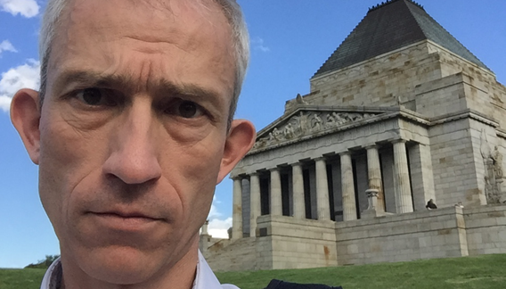

My Resolution

Slide 30
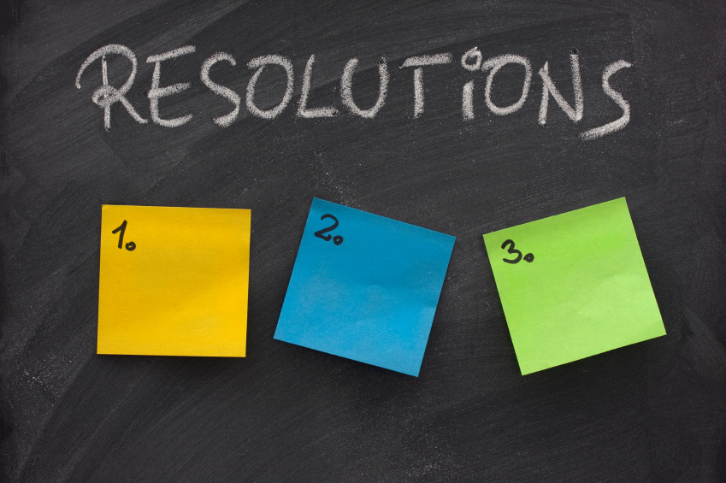
Code with Honor
Be proud
Take responsibility
Hone skills and craftmanship
Focus on longevity
Be honest
Be productive
Realize value
Team up
Step up
No concessions to my professionalism

Slide 31
Code with Honor
Be proud
Take responsibility
Hone skills and craftmanship
Focus on longevity
Be honest
Be productive
Realize value
Team up
Step up
No concessions to my professionalism

Slide 32
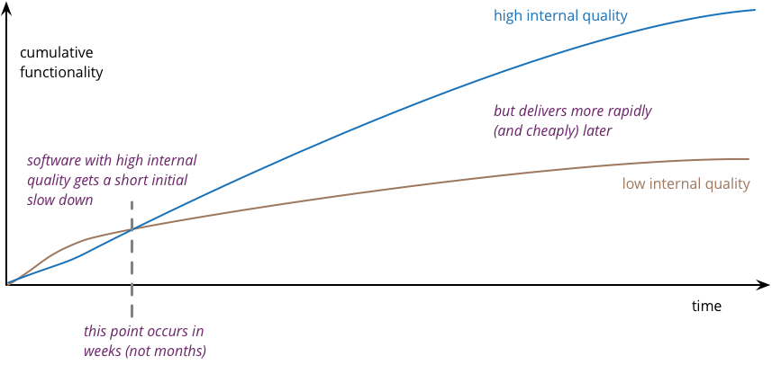
Productivity as function of time and code quality
Productivity
source: https://martinfowler.com/articles/is-quality-worth-cost.html

Slide 33
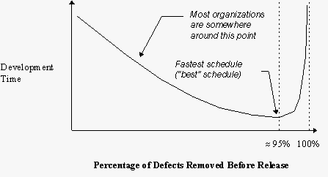
Productivity as function of % Defects Removed
source: The Economics of Software Quality - https://dev.to/bosepchuk/the-one-chart-every-developer-must-understand-2db9.
Notes:
https://dev.to/bosepchuk/the-one-chart-every-developer-must-understand-2db9
Capers Jones with co-author, Olivier Bonsignour titled The Economics of Software Quality.

Slide 34
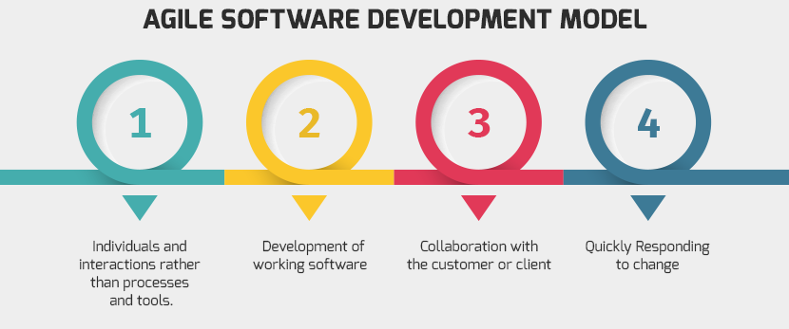
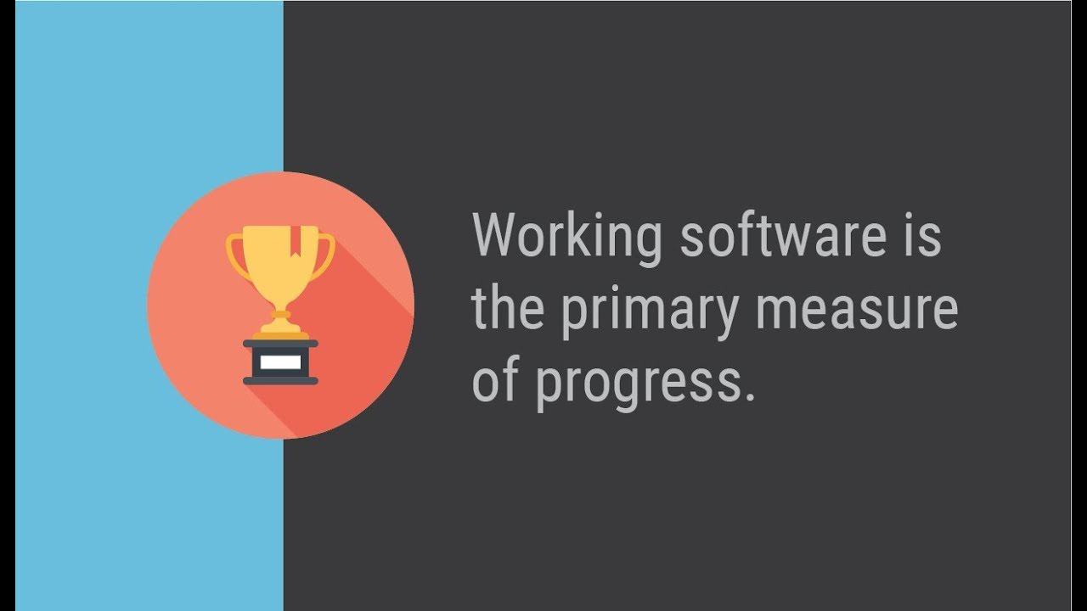

Slide 35
Working Software
What work does it do?
How can you tell?
Working Software

Slide 36
Small step for mankind…
From Working Software
To Professional software

Slide 37
Professional Software is ABLE Software
Verifi
Test
Oper
Read
Evolv
Maintain
Observ
Scal
Recover
Prov
Afford
Deploy
Audit
Impenetra
ABLE

Slide 38
What is software?

Slide 39
What is software? Any instruction executed by a machine!

Slide 40
Types of code - with distinctions in test, management, release , monitoring
Busines Run Time
Application
Platform
Deploy/Provision Time
Infrastructure
Notes:
Mergeable
Granularity/unit of… delivery/build/
Code analysis
Structured (declarative)

Slide 41

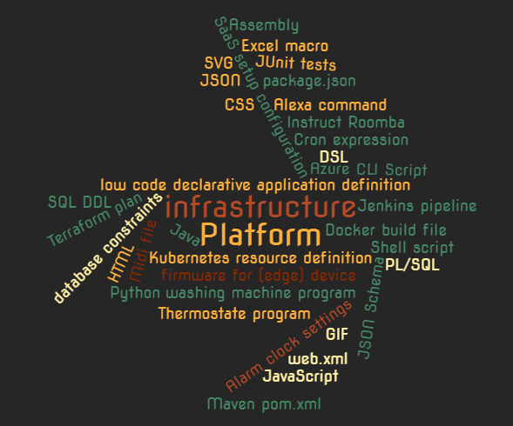
Everything is Code

Slide 42

Case in point
business critical
old
legacy
not modern
custom software
Notes:
not extraordinary!
Old, not modern
5TB in RDBMS, 50 applications, 2000 components/programs, 1.5M “lines of custom code”
fragile/issues
end of scale
stagnant / no innovation or evolution (SoR)
Expensive TCO
Critical to business
No test sets, no specifications, no documentation
Low on expertise: with tech stack, functionality, development and ops
pile of tech debt – business always in a hurry, IT caved in; no budget to technical upgrades/maintenance
Vulnerable

Slide 43
Case in point
high technical debt
no tests, no specs, no docs
end of scale
fragile
no evolution
low on expertise
expensive TCO
Notes:
not extraordinary!
Old, not modern
5TB in RDBMS, 50 applications, 2000 components/programs, 1.5M “lines of custom code”
fragile/issues
end of scale
stagnant / no innovation or evolution (SoR)
Expensive TCO
Critical to business
No test sets, no specifications, no documentation
Low on expertise: with tech stack, functionality, development and ops
pile of tech debt – business always in a hurry, IT caved in; no budget to technical upgrades/maintenance
Vulnerable

Slide 44

Notes:
technical erosion
slowly eating away

Slide 45
Working Software
Working Software

Slide 46
Working => Professional Software
Professional Software
Working Software

Slide 47


Slide 48




Stages in Software Lifecyle
Professional & ABLE: Live Software (under Ops)
Production
DoD
Preparation
Deployable Software = DONE
Built Software
DoaD
Team
Professional Code
Developer
Working Software
DoR
Functional Specification
Behavior & Unit test
Team

Slide 49
Working
according to functional specifications and technical interfaces
proven
Working Software

Slide 50

Behavior Test
The required behavior as experienced from the outside
specify
document
verify
Working Software
DoR
Functional Specification
Behavior test
Team

Slide 51

Unit Test
Verify behavior of
APIs & Interfaces
Reusable elements
Algorithms
Aspects
Functionality
Non Functionality
Happy & Non-Happy
not: dependencies

Slide 52

Test is many things
Functional contract (specification and documentation)
Quick (REPL) feedback cycle for developer
Proof of “working”
Insulator that allows
refactoring and code optimizations
technical upgrades
Regression detector
for things changed
Health indicator & Smoke detector
Reference for (re)using code
and things unchanged but impacted by changes

Slide 53

Who creates the test?
and at what time?
Who (or what?) executes the test
at what moment | trigger?
what is the outcome
Who checks on the tests?
specification coverage
code coverage
[real world] condition coverage
timely execution of test and handling of result

Slide 54

Definition
functional specifications clear, unambiguous and understood
boundary conditions, non happy cases and exceptional situations are covered in specifications
non-functional requirements are clear
business value of feature is defined
TCO budget
Notes:
Test can only be created when story is ready
DoR
functional specifications clear, unambiguous and understood
boundary conditions, non happy cases and exceptional situations are covered in specifications
Non Functional Requirements are clear
Business Value of feature is defined
TCO budget
Reference architecture
Design & implementation guidelines
Technical Debt

Slide 55
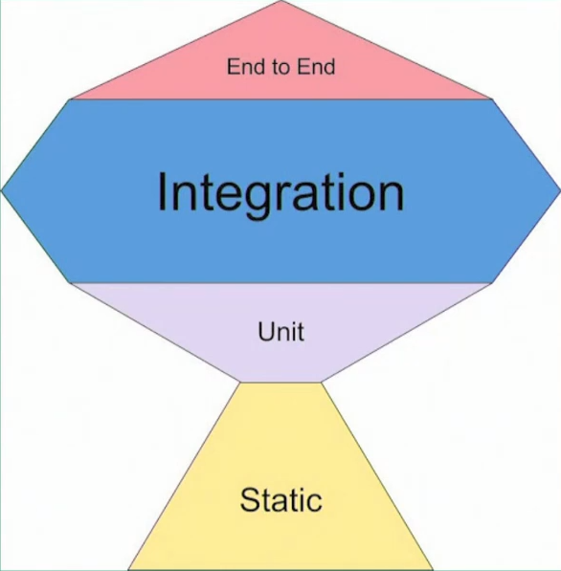
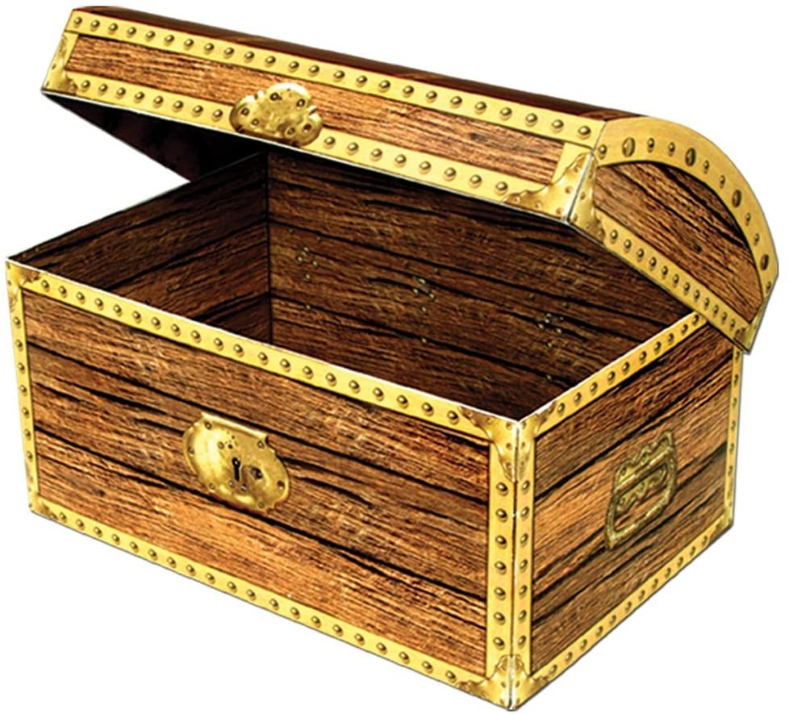
Test Trophy
Live
Test Data

Slide 56
Types of Tests
ISOLATION
more
less
Unit Test
isolated
sociable/ wired
Integration Test
Static Code Analysis
End to End Test
Smoke Test | Health Check
Chaos Test

Slide 57
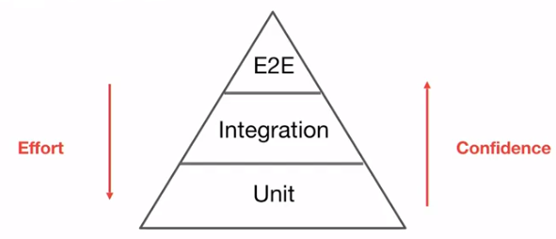
Types of Tests
ISOLATION
more
less
More:
Speed
Tests
Boundary Testing
Non-happy flows & corner cases
Mocks
Maintenance
Refactoring Protection
Technical
More:
Functional / Specification driven
Confidence
Bugs caught
Contract & Interaction
REAL (mocks poke holes in reality)
Side effect
Effort (per test)
Execution time
Unit and (most of) its internal dependencies; external dependenices are mocked
Unit Test
isolated
sociable/ wired
Integration Test
single unit, all dependencies are mocked
(aka Integration or BroadStack) test: tests include (unmocked) external dependencies; parts of the system can still be mocked
When used at runtime – E2E tests function as Smoke Test/Health Check – to test health of interactions at PaaS & IaaS level
Static Code Analysis
End to End Test
Verify code quality guideline adherence – without running any code
Some external dependencies are mocked; all internal units are used unmocked
Smoke Test | Health Check
Chaos Test
Tests in full blown environment (ACC, PROD); focus on (continuous) health – end to end availability of connections, permissions, platform and infra components; focus on important functional flows

Slide 58
Other Types and Scopes of Tests
Integration Test
Only mocks at the far ends of the chains
Smoke Test/Health Check
Live environment, no mocks
Live test data set (with no business side effects)
System
Smoketest

Slide 59
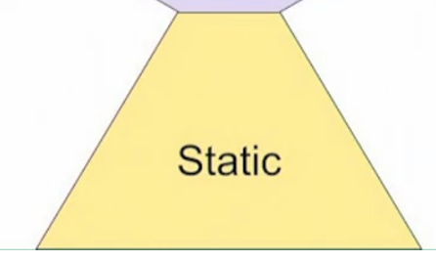


QA: Static Code Analysis
According to coding standards
Consistent
Readable
Maintainable (Code Smells)
Limited complexity
Code Coverage (of tests)
Vulnerabilities (in dependencies)
Automatic improvements

Slide 60
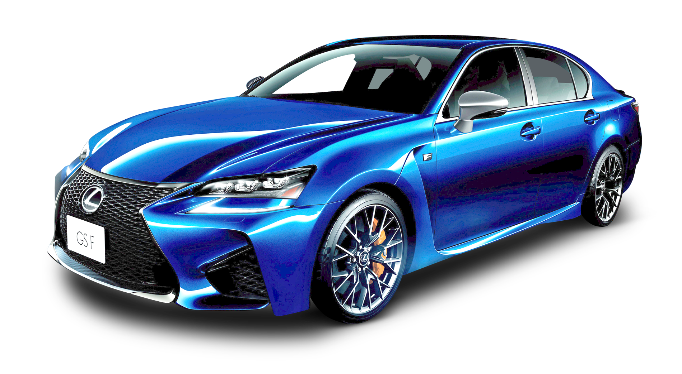
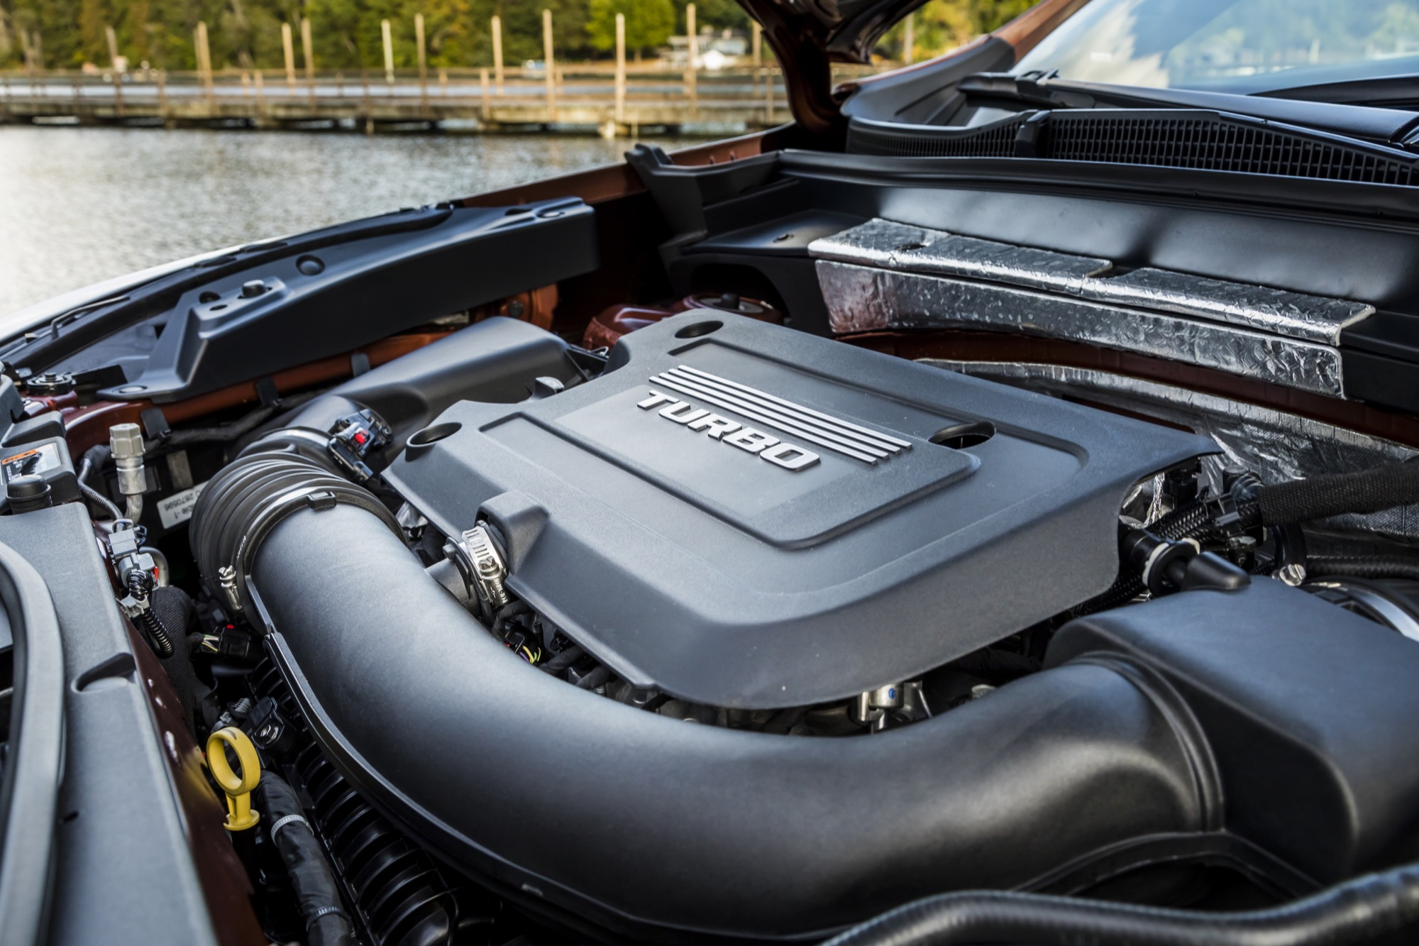
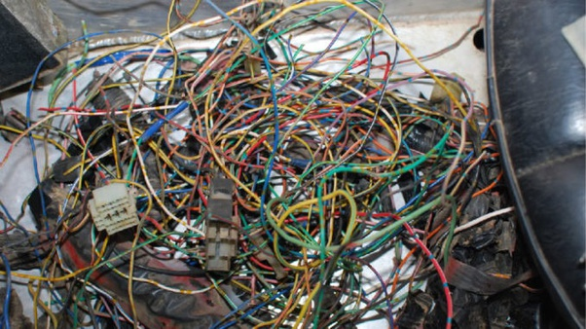
Refactoring

Slide 61
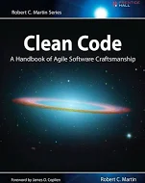
Refactoring
Compliance with coding standards
Reducing complexity
Increasing readability
Testable & test coverage
Operable
logging
metrics
configuration settings
Life cycle management of technology stack & technical debt
Needed: Local build pipeline and runtime environment to quickly and frequently do code analysis, pull & merge from master, build & automated test
DoaD
Professional Code
Developer
Refactoring
Working Software
Unit tests & QA
(Behavior Tests)

Slide 62

private void calculatePayroll (SpecialList<Employee> employeeGroup) {
while (employeeGroup.HasMore()) {
Employee employee = employeeGroup.getNext(true) ;
employee.updateSalary() ;
Payroll.distributeCheck(employee) ;
}
}
private void process (SpecialList
g) { while (g.
HasMore()) { e =
g.getNext(true) ; e.
updSal
() ; /* discard check for temp workers */ Prl.
disChk(e) ; }
}

Slide 63
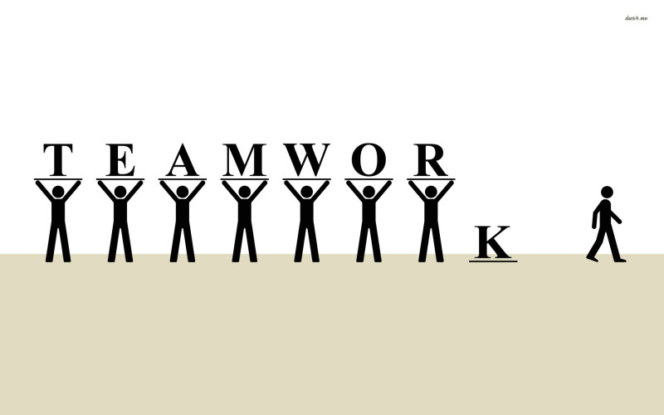
Team
That story is in Janet’s area
Sorry, Tom is on leave so we cannot work on X right now
Our tester is working on running all automated tests
Ellen is the only one on our team who can work on the Python components
Thomas knows how the CI/CD pipelines work
I am not sure what business feature Sophie is working on this sprint
Bob built it, he knows how to demo it
This [one year] old code is hard to maintain because the person who built it has left the team

Slide 64
Metamorphosis – the miracle of the PR
Notes:
Caterpillar to Butterfly
From personal code to team treasure
From branch to trunk
From mine to our

Slide 65
Metamorphosis – the miracle of the PR
PR
Pull Request
Peer Review
Production Ready
Notes:
Caterpillar to Butterfly
From personal code to team treasure
From branch to trunk
From mine to our

Slide 66
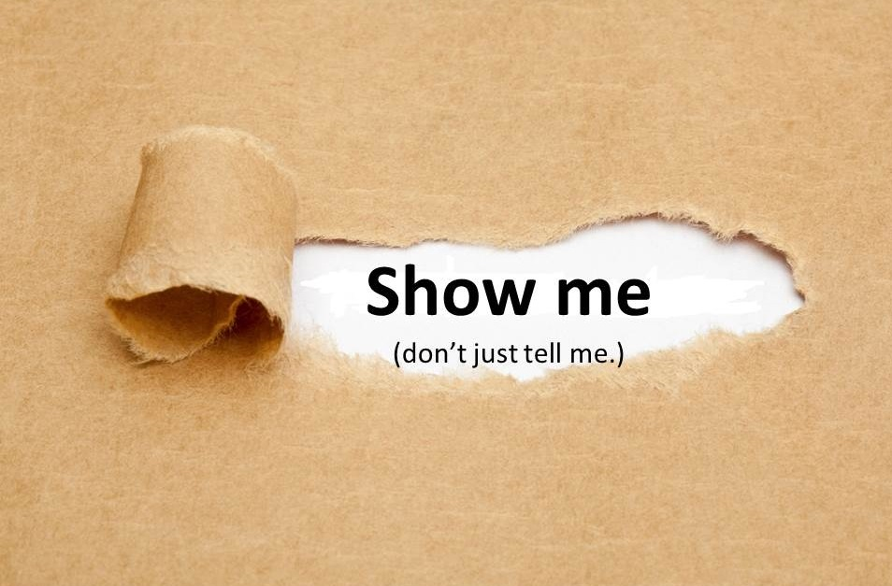
Pull Request == Please Review ?!
DoaD
Team
Professional Code
Developer
Appreciate my work
Help me improve it
and become a better developer
Take co-ownership of this code

Slide 67

Peer Review completes the Pull Request
Peer Review completes (only) when
Code is ABLE
and beautiful
the code is merged from the branch to the trunk
and the tram may roll in
because the peer considers the code their own
Give priority to Peer Review!
this takes real commitment and substantial time!
Team
Professional Code
Developer

Slide 68
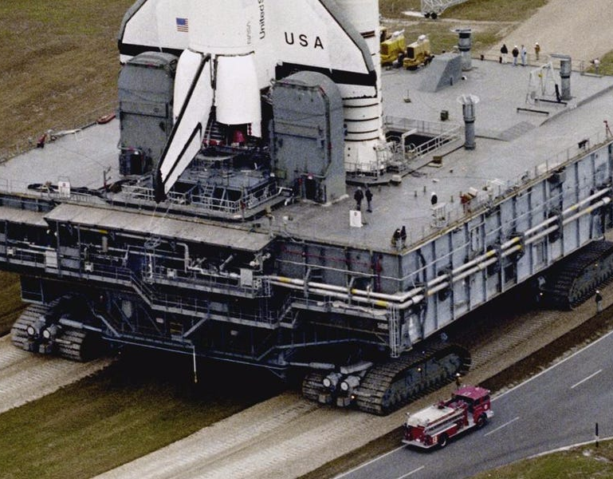
Definition of Almost Done
Code on trunk
ABLE
Compiles | Can be Built
Satisfies
QA
Test (behavior & code)
Non-functional characteristics (absolute & trend)
Vulnerability
Guidelines and Standards
Automated CI/CD pipeline
(covered by) Smoketest
Technical Debt management
Built Software
Professional Code

Slide 69
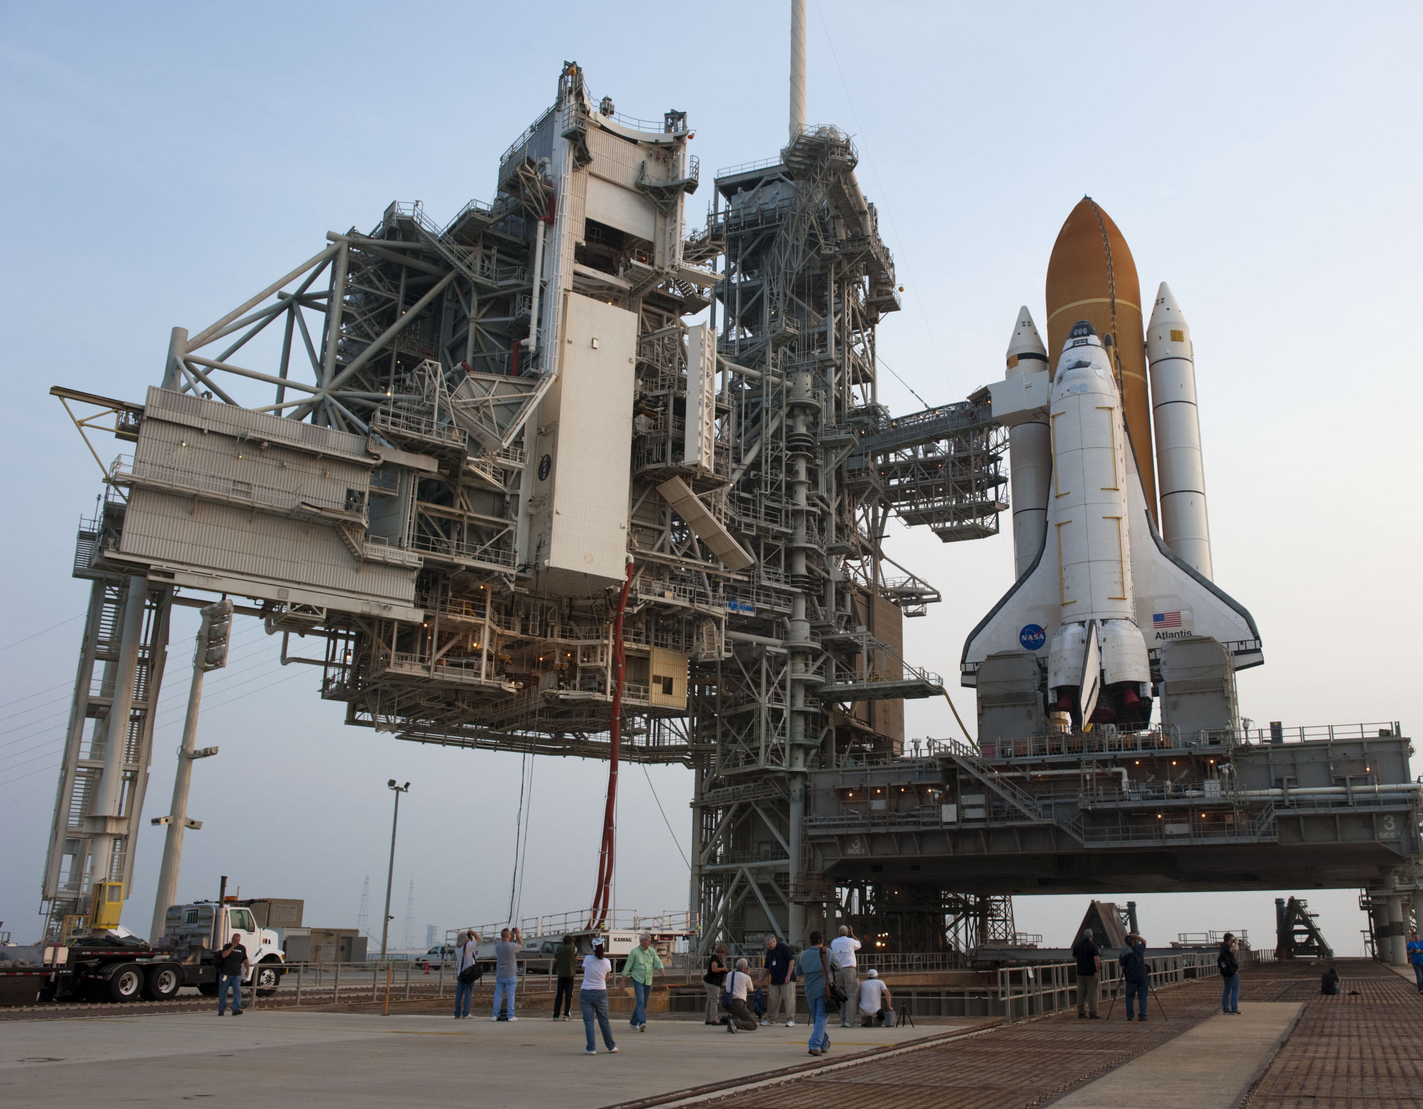
Deployable == Done (as far as team is concerned)
Deployable – but not yet deployed
deploy decision is up to business
CI/Continuous Delivery = fully process up to deployability
Continuous Deployment: automatic roll out when DONE
Deployable Software = DONE
DoD
Built Software
Professional Code

Slide 70
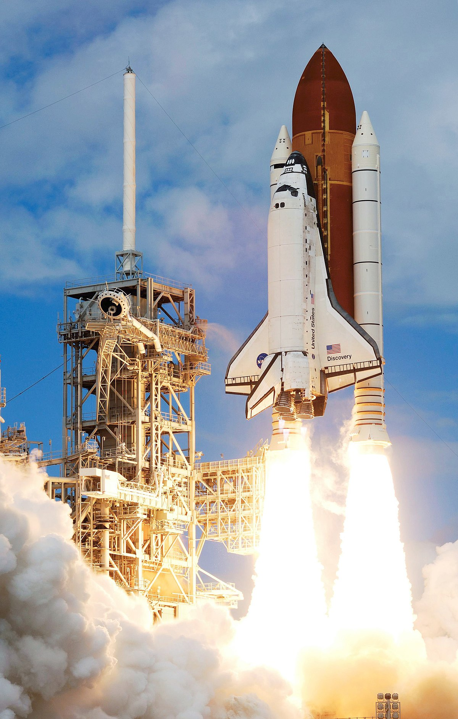
Deploy
Business decision
Automated – no touch
Smoketest post deployment (and periodically to check on health)
Operations activated
Professional & ABLE: Live Software (under Ops)
Production
Preparation
Deployable Software = DONE
Built Software

Slide 71
Smoke test
End to End – on selected, critical functional chains
black box
in acceptance and production
Healthcheck
after roll out and major change in Application and Platform/Infra
periodically to verify health
Functional (proper response and side effects) and non-functional (available, response time)

Slide 72
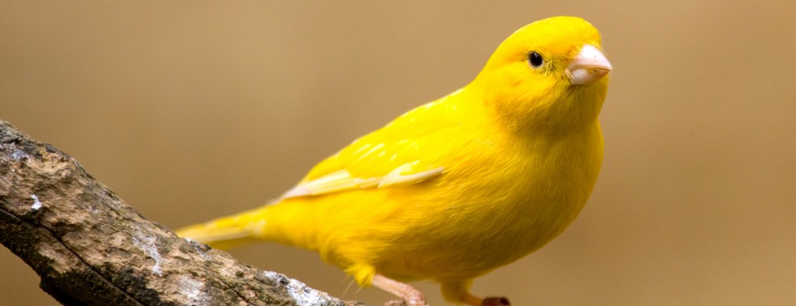
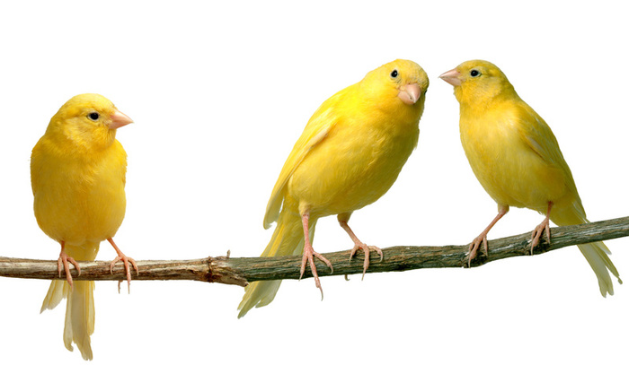
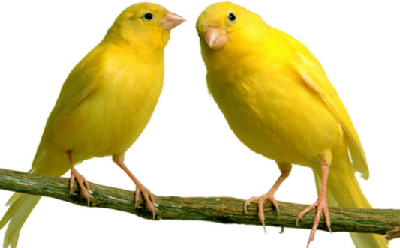
Canary
Notes:
ultimate test is production
controlled production roll out is one way to perform (final) test

Slide 73
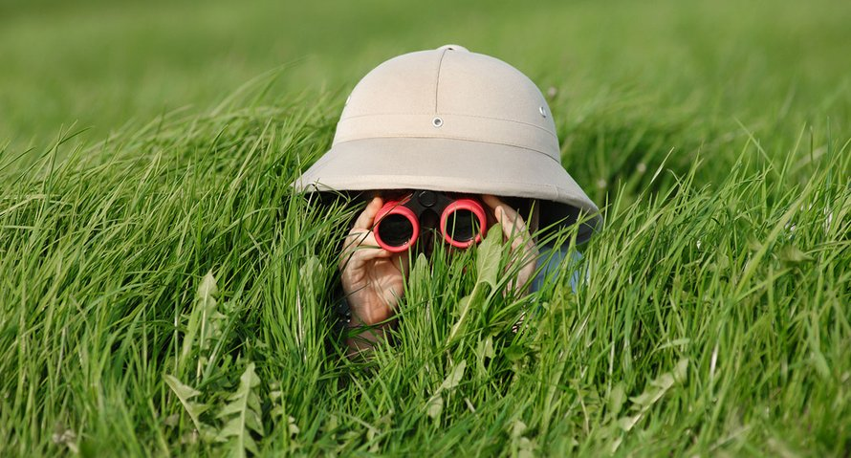
Observe the canary
Notes:
log analysis (splunk, elastic, azure or OCI log analytics)
metrics analysis
real time and trends

Slide 74
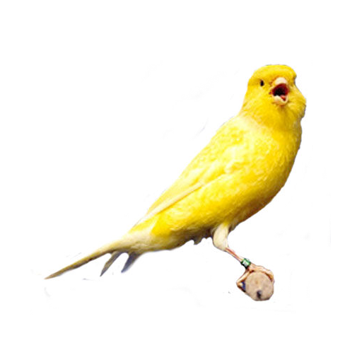
Fix Forward
Not a special procedure nor a special environment
Tiered roll out
Spot issue [very quickly]
Assign priority
Define test (to reproduce and guard against regression)
Create fix on branch
working code
professional code
PR and Merge to trunk => DONE
<business decision>
Roll Out

Slide 75
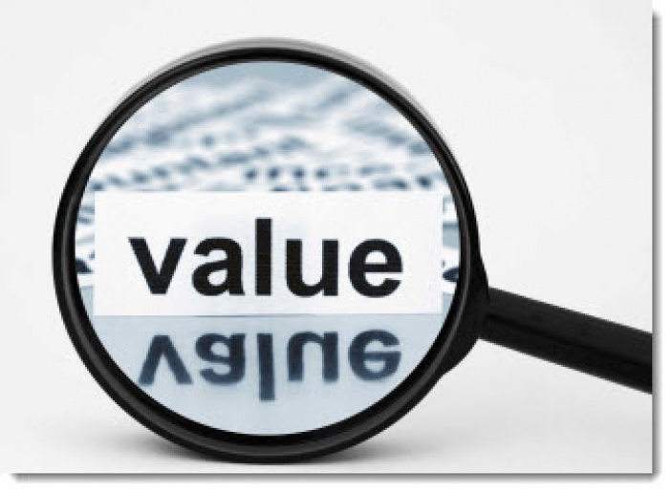
Professional Software – Generating Value for the Business

Slide 76


Slide 77
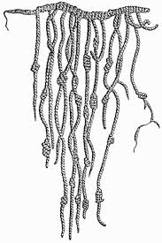
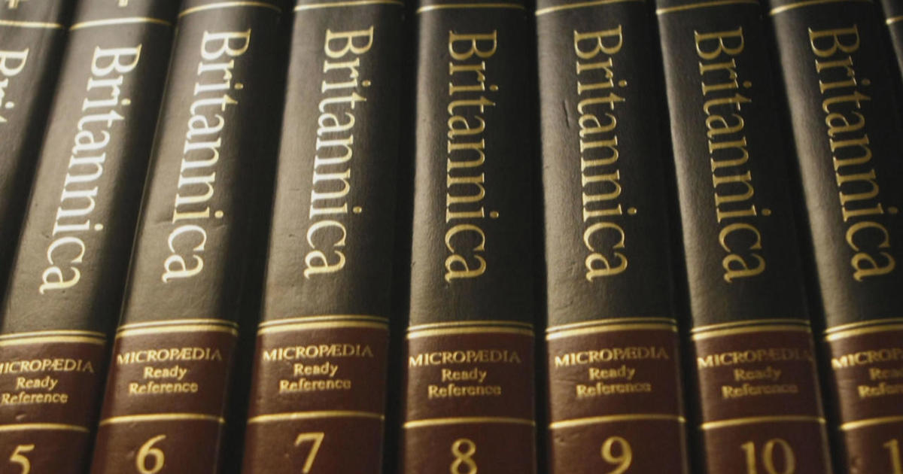





Software Wears Down

Slide 78

Life Cycle Management – Technical Maintenance
Triggers for technical change – proactively monitored by the DevOps Team
A CEV vulnerability (CVE database https://www.cvedetails.com/) Release (or patch) of 3rd party library/framework New or deprecated (feature in) PaaS Service Custom pricing in used or unused service New specification from the business New non-functional requirement Incident/bug – functional or non-functional Technical debt assessment New version of platform component:
eg Docker, Kubernetes, Java, Node
New/custom architecture choice/guideline New/custom coding standard New tool, new version of tool Law & Regulation, Ethical Insights Mere Progression of Time
Notes:
Elk event leidt tot technical debt en/of actie/user story
DevOps team houdt status bij van applicatie-componenten en platform-onderdelen en tools (functioneel, non-functioneel en technisch

Slide 79
What Time can Do…
Notes:
technical erosion
slowly eating away

Slide 80





























Some Suggested Tools – by no means exhaustive
Generic
Technology Specific
Professional & ABLE: Live Software (under Ops)
Production
Preparation
Deployable Software = DONE
Built Software
Team
Professional Code
Developer
Working Software
Functional Specification
Behavior & Unit test
Team
Notes:
https://angiejones.tech/writing-good-gherkin-enables-good-test-automation/

Slide 81


Slide 82







Professional Code
Working Software
Notes:
Code with Honor
Professional Software
Able Software
readable , maintainable, refactorable, testable (and tested), buildable and deployable (automatically), operable, evolvable
team owned
Be proud
look anyone (especially your mother) in the eye and declare “our software is high quality”
Have fun coding and experience purpose from the outcome
Definition of Ready & Done
Automation of CI/CD
Automation of Testing – behavior, functional, non-functiona;l
TD management
tools for source code control (incl PR/MR), Test, QA, Build, Artifact Mgt, Deploy, Log, Monitor
Peer Review

Slide 83
Professional Code
Working Software
Notes:
Code with Honor
Professional Software
Able Software
readable , maintainable, refactorable, testable (and tested), buildable and deployable (automatically), operable, evolvable
team owned
Be proud
look anyone (especially your mother) in the eye and declare “our software is high quality”
Have fun coding and experience purpose from the outcome
Definition of Ready & Done
Automation of CI/CD
Automation of Testing – behavior, functional, non-functiona;l
TD management
tools for source code control (incl PR/MR), Test, QA, Build, Artifact Mgt, Deploy, Log, Monitor
Peer Review

Slide 84

Professional Code
Working Software
Notes:
Code with Honor
Professional Software
Able Software
readable , maintainable, refactorable, testable (and tested), buildable and deployable (automatically), operable, evolvable
team owned
Be proud
look anyone (especially your mother) in the eye and declare “our software is high quality”
Have fun coding and experience purpose from the outcome
Definition of Ready & Done
Automation of CI/CD
Automation of Testing – behavior, functional, non-functiona;l
TD management
tools for source code control (incl PR/MR), Test, QA, Build, Artifact Mgt, Deploy, Log, Monitor
Peer Review

Slide 85
Thank you for your attention I hope this was useful
lucas.jellema@amis.nl | technology.amis.nl | @lucasjellema | lucas-jellema

Slide 86


Slide 87



